Slide 1
3D Modelling
Web RELATED TUTORIAL
By TEAM 6-9

Slide 2





Team Members
Zaiba Ali Marton Bagoly Sathwika Gone Hari Priya Jupally Sai Krishna Teja Kancharla

Slide 3
What is 3D Modelling?
A technique of CG for generating three dimensional digital representation of any object.
Requires a special software
Manipulation of points in virtual space known as vertices to form a mesh.
Collection of vertices form an object.
ZAIBA ALI

Slide 4
Softwares
Autodesk Maya
Autodesk 3DS MAX
Blender
Element 3D plugin for Adobe AE
Zbrush
Houdini
Cinema 4D
ZAIBA ALI

Slide 5
MAYA
3D Computer Graphics Application
Support for Windows, macOS, linux
Original Development by Alias Systems Corporation
Currently Owned and Developed by Autodesk
PAID SOFTWARE
Student License for limited time.
ZAIBA ALI

Slide 6
Specification to run Maya
Maya runs on windows 7 and above
Our CPU must be 64 bit processor
RAM must be 8 GB or more
4 GB of free disk space for installing Maya
It should have updated web browsers
SATHWIKA GONE

Slide 7
Creating a 3D Model and Exporting In MAYA
Create a 3d model:
To move object to different position we use “W” Key
To scale the object we use “R” key
To Rotate the object we use “E” key
To set the object key frame we use “S” Key
SATHWIKA GONE

Slide 8
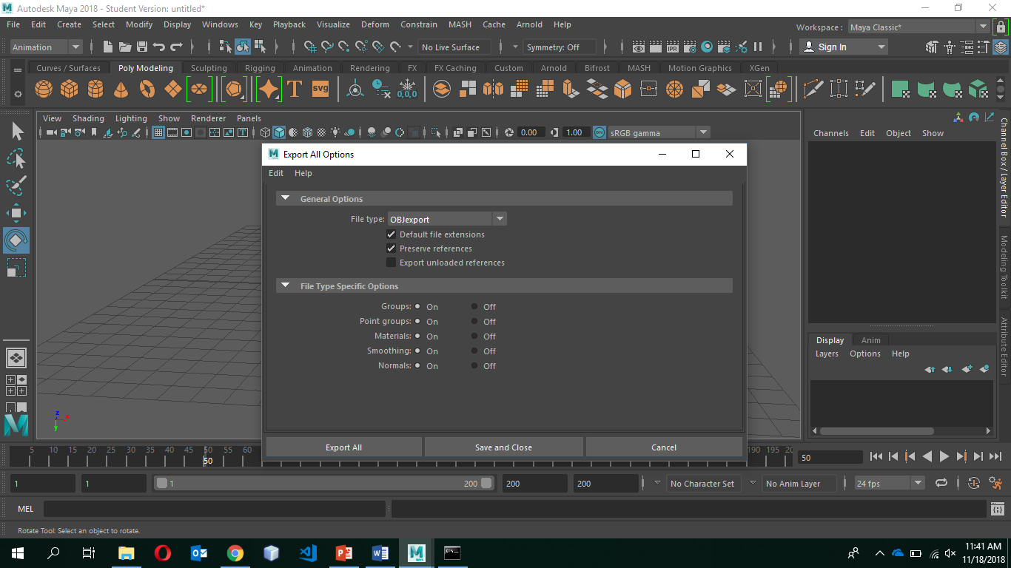
Exporting the model
SATHWIKA GONE

Slide 9
Simulations in MAYA
nCloth
The polygon mesh is hidden and we can see the cloth mesh on that object
nHair
Natural moment of hair, collision of long hair, hair when swimming underwater
nParticle
Create numerous types of effects such as fire, smoke
Fluid
Fluid Effects lets you create a wide variety of 2D and 3D atmospheric, space and liquid effects.
Biforst
You can also create fluid gas effects like smoke.
SATHWIKA GONE

Slide 10
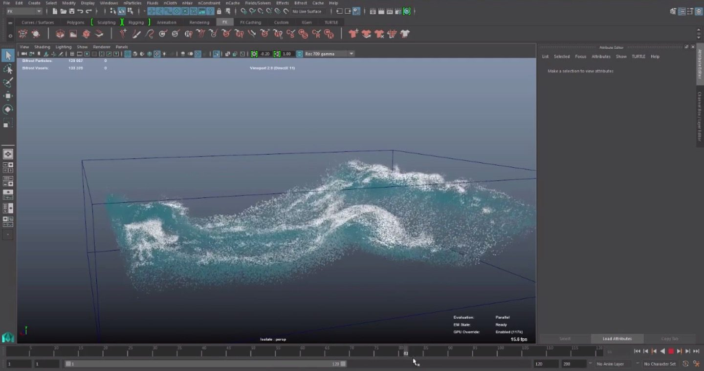


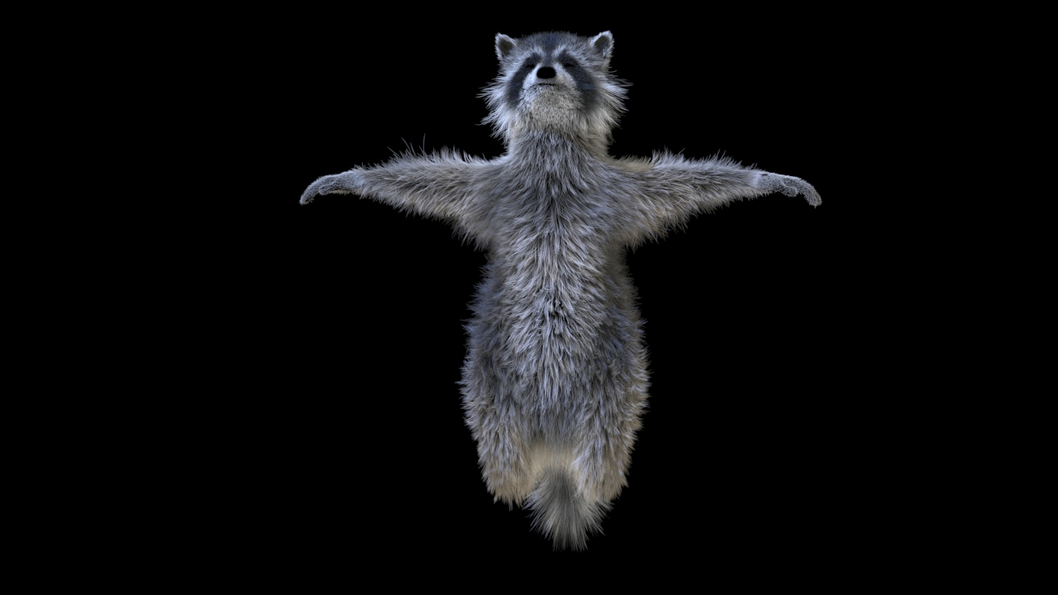
SATHWIKA GONE

Slide 11
Realtime Landscaping Architect
Design Landscape Plans
Simultaneous 2D and 3D Design
Design over a Photo or in Realistic 3D
MARTON BAGOLY

Slide 12
A 3D Model
Using Realtime landscaping architect
MARTON BAGOLY

Slide 13
Three.js
Created and Developed by Ricardo Cabello (Mr. doob)
Initial Release: April 24, 2010
Cross-browser JavaScript library
API to create and display animated 3D Computer Graphics in a web browser
Repo link: github.com/mrdoob/three.js
Website: threejs.org
Uses WebGL after its inception
HARI PRIYA JUPALLY

Slide 14
WebGL
JavaScript API for rendering interactive 2D and 3D graphics within any compatible web browser without the use of plug-ins.
Fully Integrated with other web standards
Allows GPU-accelerated usage of physics and image processing and effects as part of web page canvas.
Developed by Khronos Group
Original Author: Mozilla Foundation
Initial release: March 3, 2011
HARI PRIYA JUPALLY

Slide 15
Three.js Features
Effects: Anaglyph, cross-eyed and parallax barrier.
Scenes: add and remove objects at run-time; fog
Cameras: perspective and orthographic; controllers: trackball, FPS, path and more
Animation: armatures, forward kinematics, inverse kinematics, morph and keyframe
Lights: ambient, direction, point and spot lights; shadows: cast and receive
Materials: Lambert, Phong, smooth shading, textures and more
Shaders: access to full OpenGL Shading Language (GLSL) capabilities: lens flare, depth pass and extensive post-processing library
Objects: meshes, particles, sprites, lines, ribbons, bones and more - all with Level of detail
HARI PRIYA JUPALLY

Slide 16
Three.js Features
Geometry: plane, cube, sphere, torus, 3D text and more; modifiers: lathe, extrude and tube
Data loaders: binary, image, JSON and scene
Export and import: utilities to create Three.js-compatible JSON files from within: Blender, openCTM, FBX, Max, and OBJ
Support: API documentation is under construction, public forum and wiki in full operation
Examples: Over 150 files of coding examples plus fonts, models, textures, sounds and other support files
Debugging: Stats.js,WebGL Inspector, Three.js Inspector
Virtual reality: accessing WebVR
HARI PRIYA JUPALLY

Slide 17
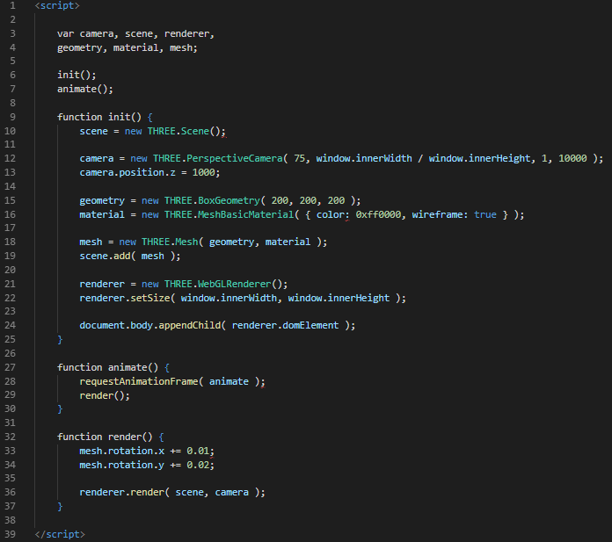
This code creates a scene, adds a camera and a cube to the scene, creates a WebGL renderer and adds its viewport in the document.body element. Once loaded, the cube rotates about its X- and Y-axis.
HARI PRIYA JUPALLY

Slide 18
Cross-Origin Resource Sharing
Cross-Origin Resource Sharing (CORS) is a mechanism that uses additional HTTP headers to tell a browser to let a web application running at one origin (domain) have permission to access selected resources from a server at a different origin. A web application makes a cross-origin HTTP request when it requests a resource that has a different origin (domain, protocol, and port) than its own origin.
For security reasons, browsers restrict cross-origin HTTP requests initiated from within scripts. For example, XMLHttpRequest and the Fetch API follow the same-origin policy. This means that a web application using those APIs can only request HTTP resources from the same origin the application was loaded from, unless the response from the other origin includes the right CORS headers.
KRISHNA TEJA

Slide 19
Lets get to the final demo
Create a model
Export it in OBJ
Load in Three.js
Run the server.
KRISHNA TEJA

Slide 20
References
Three.js official website, https://threejs.org/
Three.js GitHub Repository, https://github.com/mrdoob/three.js/
KRISHNA TEJA

